Slide 1


Databricks & Deltalake

Slide 2
History
The Genesis of Spark

Slide 3

Google is synonymous with scale
Google is a deliberate misspelling of the mathematical term googol
that’s 1 plus 100 zeros!
Store, build and search the internet’s indexed documents
Nothing could handle the scale they were operating at
led to creation of three new systems
Google File System (GFS)
MapReduce (MR)
Bigtabel

Slide 4


Proprietary
Research papers
Google File System
Map Reduce
Bigtable

Slide 5



Hadoop at Yahoo
Research papers

Slide 6
MapReduce
A programming model for processing and generating big data sets with a parallel, distributed algorithm on a cluster
Bread and butter!
Commonly used in functional programming
Map procedure: filtering and sorting
Reduce procedure: summary operation

Slide 7
Hadoop Framework = meh
Map Reduce implementation had shortcomings
hard to manage and administer
cumbersome operational complexity
Verbose API (boilerplate setup code)
Brittle fault tolerance
IO operations -> slow
large MR jobs could run for hours on end, or even days
Could not combine other workloads such as machine learning, streaming, or interactive SQL-like queries

Slide 8

Hadoop and MR simpler and faster?
UC Berkeley had worked with Hadoop MapReduce and accepted the challenge
Started the project Spark!
Borrowed from Hadoop Map‐ Reduce, but enhance
highly fault tolerant
embarrassingly parallel
in-memory storage (intermediate results)
Multiple languages
Easy and composable API’s

Slide 9
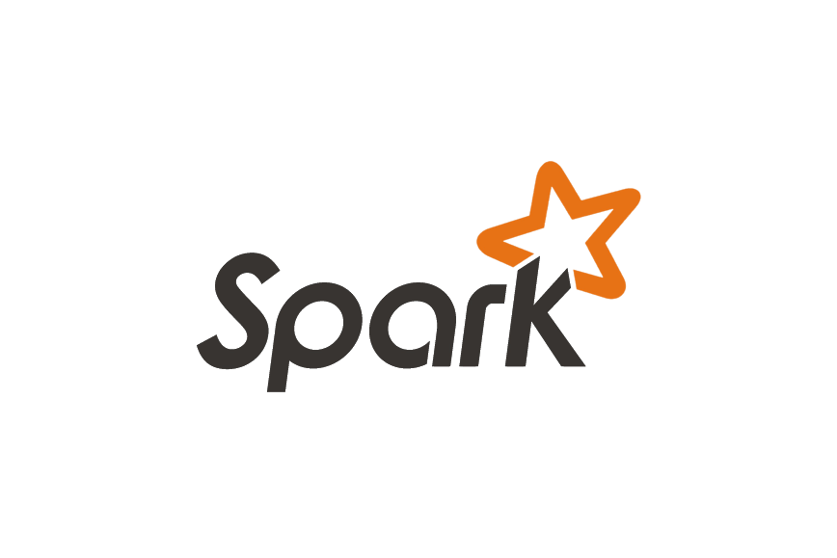
Apache Spark
A unified engine designed for large-scale distributed data processing
Spark provides in-memory storage for intermediate computations
Spark’s design philosophy centers around four key characteristics
Speed
Ease of use
Modularity
Extensibilty
In 2013, the creators donated the Spark project to the Apache Software Foundation and formed a company called Databricks

Slide 10
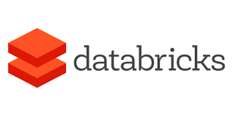
Databricks
A company providing a platform
Unified data analytics platform
data engineering
data science
machine learning
Analytics
Based on Apache Spark framework

Slide 11


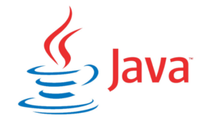

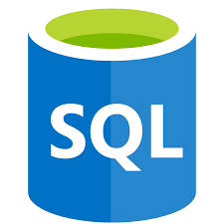
Language Support

Slide 12
Databricks Cluster
Cluster: set of computation resources
Distributed processing!!!
Notebooks must run on a cluster
All purpose vs Jobs
All purpose: lives for X amount then slumbers
Jobs: runs til job is done, then dies forever

Slide 13
Pools
By maintaining a set of idle,ready-to-use instances
reduce cluster start
Reduce auto-scaling times
Manage subscription VM limit?

Slide 14
The Dataframe
Everything is centered around dataframes
Provides a rich set of functions (select columns, filter, join, aggregate etc)
the most common Structured API and simply represents a table of data with rows and columns
Read into dataframe, write dataframe to storage
Working with streaming and batch is just working with a dataframe

Slide 15
DBFS
Databricks File System
A distributed file system mounted into a Databricks workspace
An abstraction on top of scalable object storage
Benefits:
Mount storage objects -> seamlessly access data without requiring credentials.
interact with object storage using directory and file semantics instead of storage URLs
Persists files to object storage, so you won’t lose data after you terminate a cluster.

Slide 16
Delta Lake

Slide 17
Why is Delta Lake
Spark writes are not atomic and data consistency is not guaranteed
Data lakes often have multiple pipelines reading and writing data concurrently
Hard to ensure data integrity, due to the lack of transactions
When metadata itself becomes big data, it is difficult to manage data

Slide 18
What is Delta lake?
Delta Lake is a project that was developed by Databricks and now open sourced
Storage layer that sits on top of the Apache Spark services which brings reliability to data lakes
Core features:
ACID transactions (atomicity, consistency, isolation, durability)
scalable metadata handling
unifies streaming and batch data processing

Slide 19
How does it work?
Delta lake provides a storage layer on top of existing cloud storage data lake
Acts as a middle layer between Spark runtime and cloud storage

Slide 20

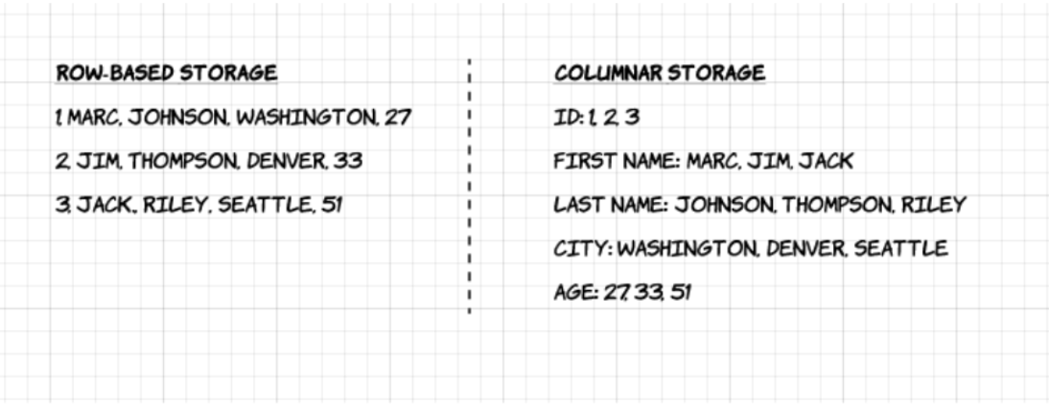
Apache Parquet Files
Columnar storage
As apposed to row-based files like CSV or Avro
Metadata including schema and structure is embedded within each file
Can store nested data
Optimized for queries that process large volumes of data (Gb range)

Slide 21
Delta Lake Key Features
ACID Transactions (Atomicity, Consistency, Isolation, Durability)
Scalable Metadata Handling
Unified Batch & Streaming
Schema Enforcement
Time Travel (Data Versioning)
Upserts and Deletes
100% Compatible with Apache Spark

Slide 22
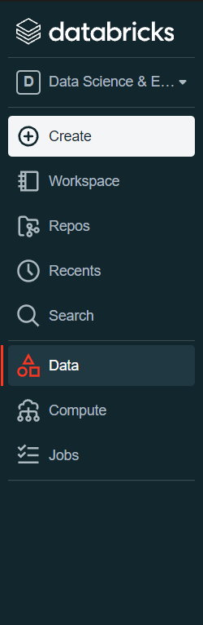
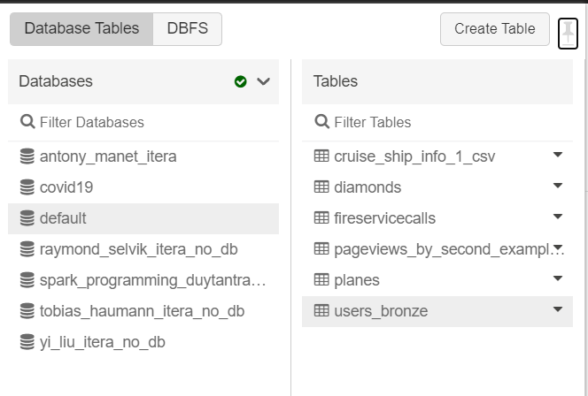
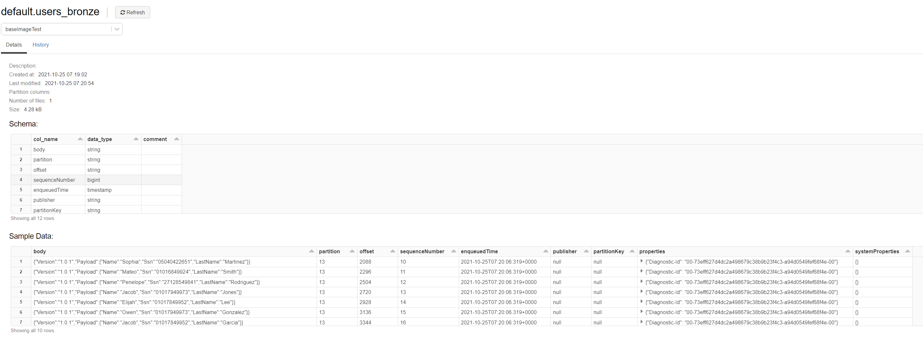
Delta Table
Virtual tables on top of your delta lake folders

Slide 23
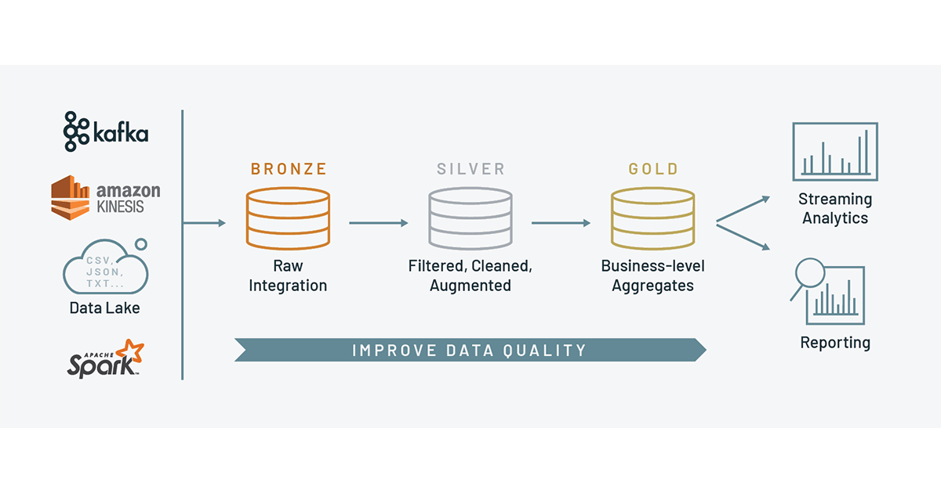
Medallion Model

Slide 24
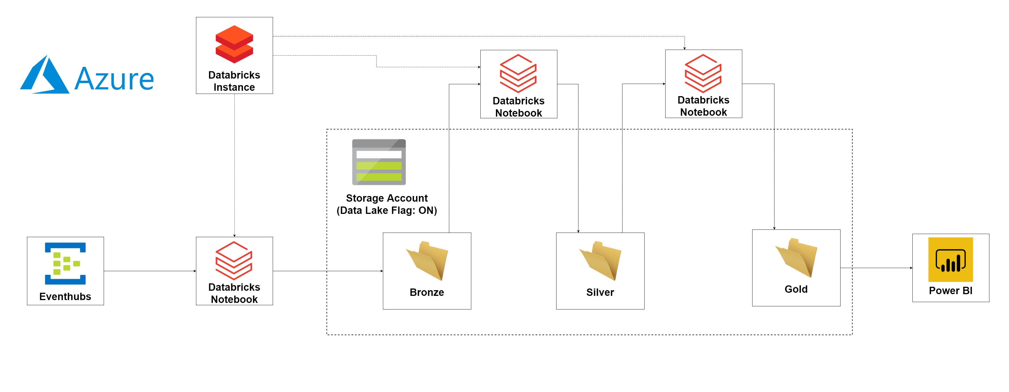
Medallion Model

Slide 25
Tasks
Garden’s of trees
Objective:
read simple files
Play around with dataframes
Join operation
Aggregate and group by
Min/max
User Medallion Model
Objective:
Read and write streams
Create Delta tables
Tranformations

